Slide 1
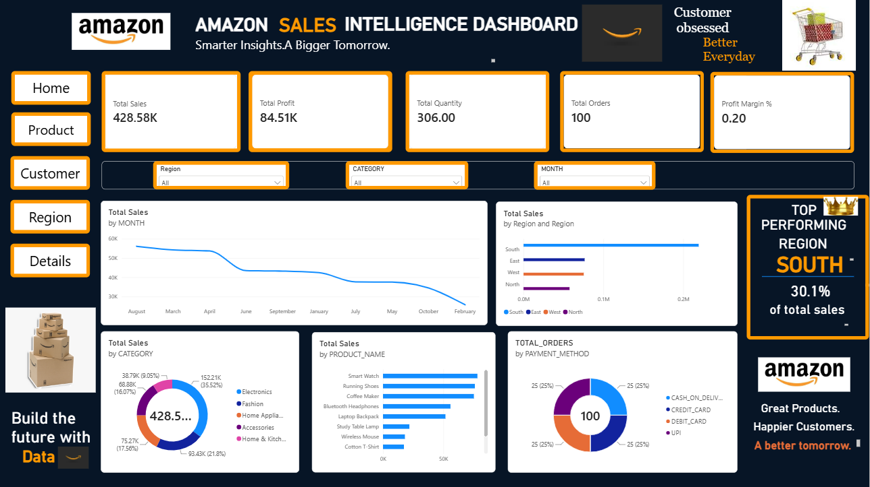
AMAZON
Sales Intelligence Dashboard
User Guide
Smarter Insights. A Bigger Tomorrow.
Prepared by Sinegavalli.S
Notes:
Welcome. This guide shows how to read and use the Amazon Sales Intelligence Dashboard.

Slide 2





The dashboard at a glance
One Power BI report, five pages. Each page answers a different business question from the same sales data.
Amazon Front
Product Performance
Customer Analytics
Region-wise Performance
Sales Detail Explorer
Overall KPIs, trends and top region
Which products earn the most
Who buys and how much they spend
Sales and profit by region, state, city
Transaction-level records
Data model: FACT_TABLE (sales) filtered by DIM_DATE, PRODUCT, CUSTOMER and REGION

Slide 3
Finding your way around
1
Navigation buttons
Home, Product, Customer, Region and Details on the left switch pages.
2
2
KPI cards
1
3
Headline numbers for the current filter selection.
5
3
Slicers
4
Region, Category and Month drop-downs narrow every visual.
4
Charts
Trends, splits and rankings. Click any bar or slice to cross-filter.
5
Top region call-out
The left-hand navigation stays in the same place on every page.
Highlights the best-performing region.

Slide 4
Reading the KPI cards
428.58K
84.51K
306
100
20%
Total Sales
Total Profit
Total Quantity
Total Orders
Profit Margin
Sum of all sales amounts
Sales amount minus costs
Units sold
Number of orders placed
Profit divided by sales (shown as 0.20)
Values shown are for the full data set (Region, Category and Month = All). Every card recalculates when you change a slicer.

Slide 5



Home page charts explained
Total Sales by Month
Line chart of the sales trend over time
Total Sales by Region
Bar chart ranking South, East, West and North
Total Sales by Product
Bar chart of best- and worst-selling products
Total Orders by Payment Method
Donut: Cash on Delivery, Credit Card, Debit Card, UPI
Electronics leads with 35.52% of sales.

Slide 6

Filter and explore
1
Choose a value in a slicer
Open the Region, Category or Month drop-down and pick an option. Every KPI and chart updates.
Try this
2
Select more than one
Set Region to South.
KPI cards now show South only.
Then set Category to Electronics.
See Electronics sales in South, by month and product.
Hold Ctrl while clicking to choose several values, for example two regions.
3
Click a chart element
Click a bar, slice or column to highlight it and filter the other visuals. Click it again to undo.
4
Reset
Set slicers back to All or use the clear-selection icon on the slicer.

Slide 7

Product Performance
Which products drive sales, profit and volume?
Top product cards
Product charts
Details table
Best product, its sales and its profit.
Sales by product (bar), profit by product (donut), quantity by product (column).
Product, category, orders, sales, profit and quantity in one list.

Slide 8
Customer Analytics
KPI cards
Questions it answers
Total customers, average order value, top customer sales
Who are the top customers?
Which customer type spends more?
How does spend differ by gender?
What is the average order value?
Top customers
Bar chart ranking customers by sales
Segments
Sales by customer type (donut) and by gender (column)
Matrix
Customer name by product category, showing sales

Slide 9

Region-wise Performance
Top region cards show the leading region with its sales and profit. South leads with 30.1% of total sales.
Sales by Region
Sales by State
Bar chart comparing South, East, West and North
Bar chart of state-level sales
Sales by City
Profit by Region
Pie chart of each city's share
Column chart of profit for each region
Use the Region slicer to focus the whole page on one region.

Slide 10
Sales Detail Explorer
Go from summary numbers to individual transactions.
1
2
3
4
Open the page
Narrow the data
Read the table
Sort and drill
Click Details in the left navigation.
Use the Product Name and Region slicers.
Sales ID, customer, product, region, date, quantity, sales amount and profit.
Click a column header to sort. Expand the date from year to quarter, month and day.
KPI cards at the top (sales, profit, orders, quantity) always match the rows shown below.

Slide 11

Tips and troubleshooting
Tips
If something looks off
Start on Home, then drill into a page.
Compare regions by clicking one bar at a time.
Check which slicers are active before quoting a number.
Use Details to verify any total you are unsure about.
Visuals look empty: a slicer is filtering everything out. Reset to All.
Months are out of order: the trend chart is sorted by value, not by calendar.
Margin shows 0.20: this is 20% in decimal format.
Top region text does not change with slicers: it is typed text, not a calculation.

Slide 12



Ready to explore
Navigate
Filter
Explore
Use the left buttons to switch pages
Use Region, Category and Month slicers
Click charts and open Details for the rows
Amazon Sales Intelligence Dashboard | Prepared by Sinegavalli.S

